Slide 1

Ipl Data Analysis
Using Matpltlib
G.SATHVIK

Slide 2

Table of Contents
Introduction
Getting Started
Overview of project

Slide 3
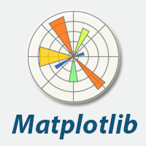
Introduction
Matplotlib is a widely used data visualization library for the Python programming language. It provides a comprehensive set of tools for creating various types of plots, charts, and graphs, making it a popular choice among data analysts, scientists, and researchers.
Matplotlib is a low level graph plotting library in python that serves as a visualization utility.
Matplotlib was created by John D. Hunter.
Matplotlib is open source and we can use it freely.

Slide 4
Getting Started
Matplotlib is a in built package in python it can be imported into python IDE with simple comand
Now we can start use different methods and functionality of Matplotlib

Slide 5
Overview of project
With the help of dataset provided in form of text document is added to Jupiter notebook and both NumPy and Matplotlib packages are imported now we can start plotting graphs.
Note: The dataset and .ipynb file of project will be shared

Slide 6
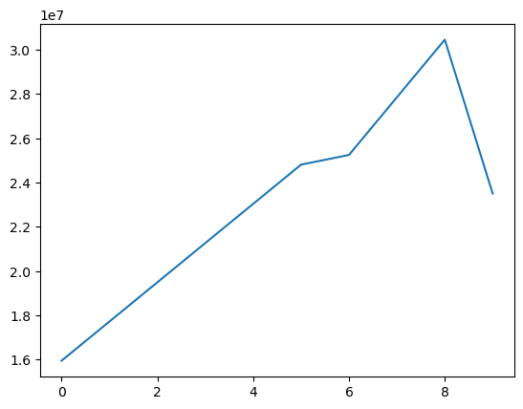

Generating graphs
To plot a simple graph player Sachin salary

Slide 7
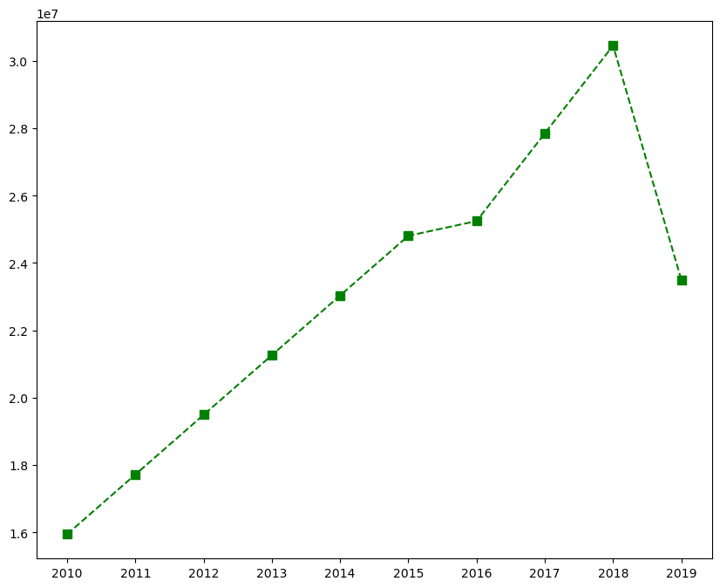
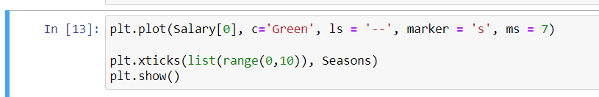
Generating graphs
Sachin salary graph with a bit of information
In this graph we can observe sachin salary significantly increased till 2018 and there is a huge fall in 2019

Slide 8
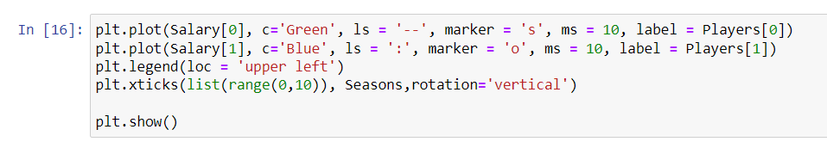
Comparing Two Players Salary
Comparing salary's of Sachin and Rahul

Slide 9
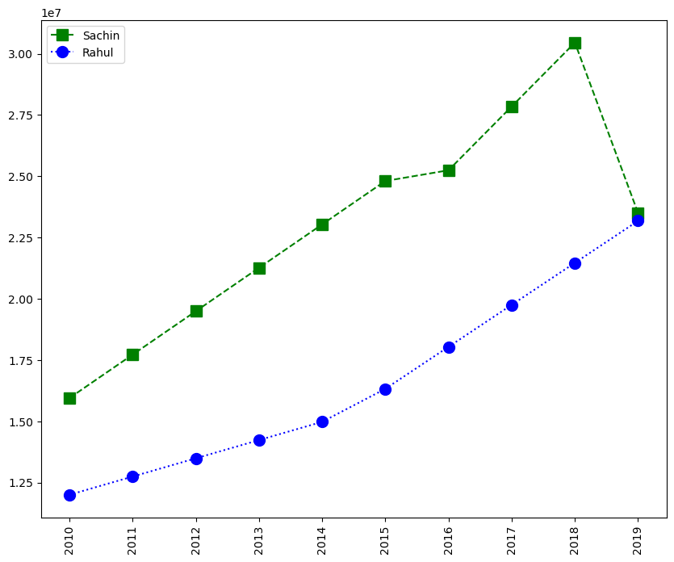

Slide 10
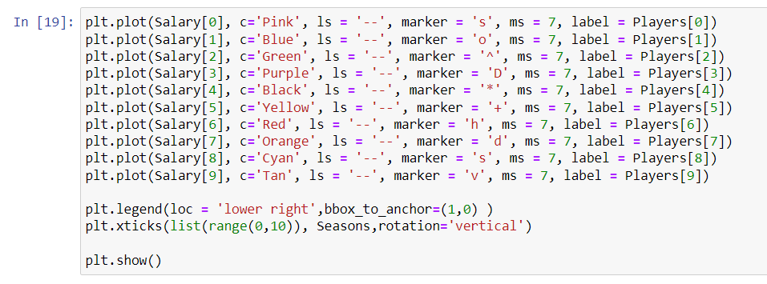
Analyse all Players Salary

Slide 11
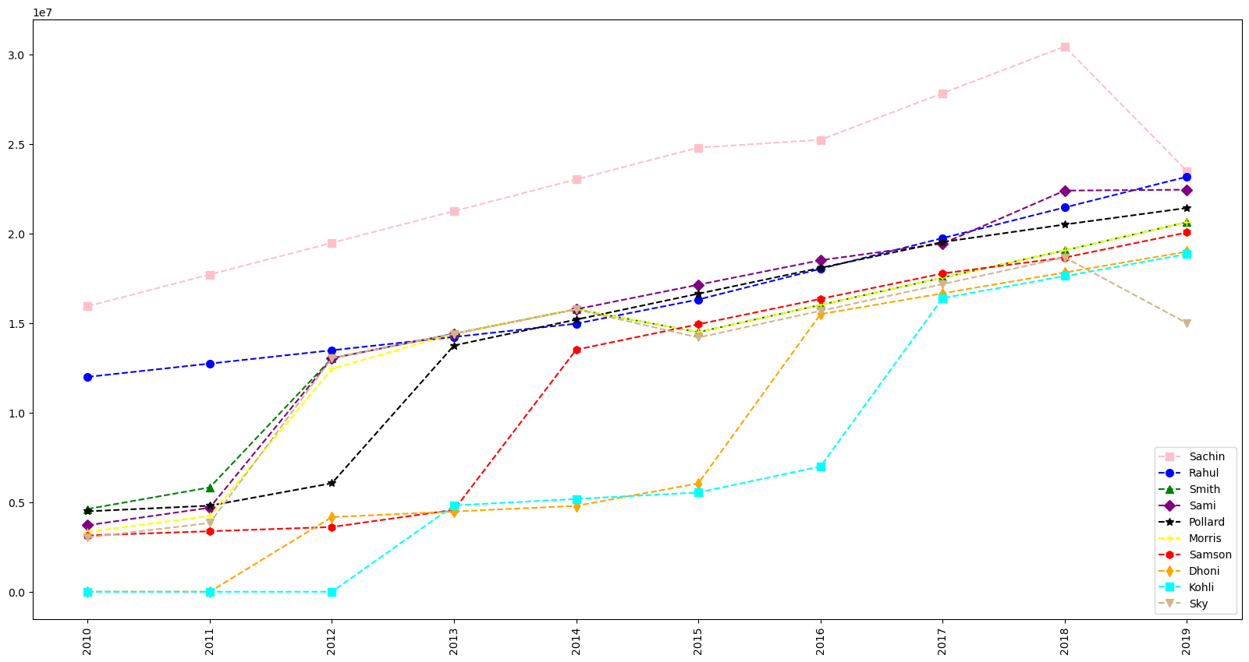

Slide 12
Insights from graph
Sachin has the highest salary comared to other players in all seasons except 2019
Rahul has significant increase in salary in every season
Every other player had an instantaneous growth in salary between 2011 to 2016
Dhoni and Kohli started there salary from lowest than others

Slide 13
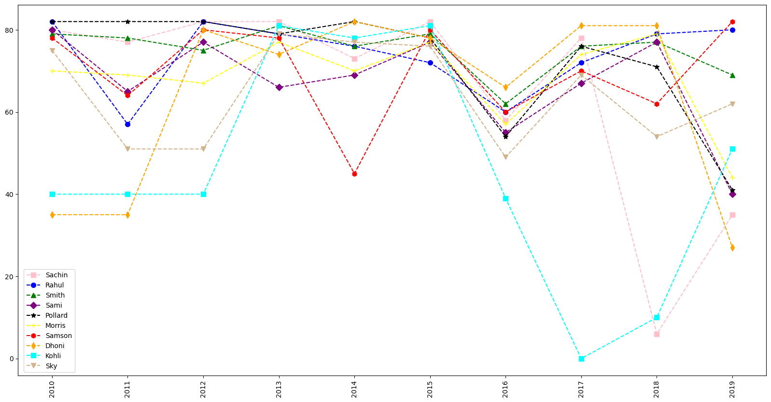
Other Parameters
Player
Games

Slide 14
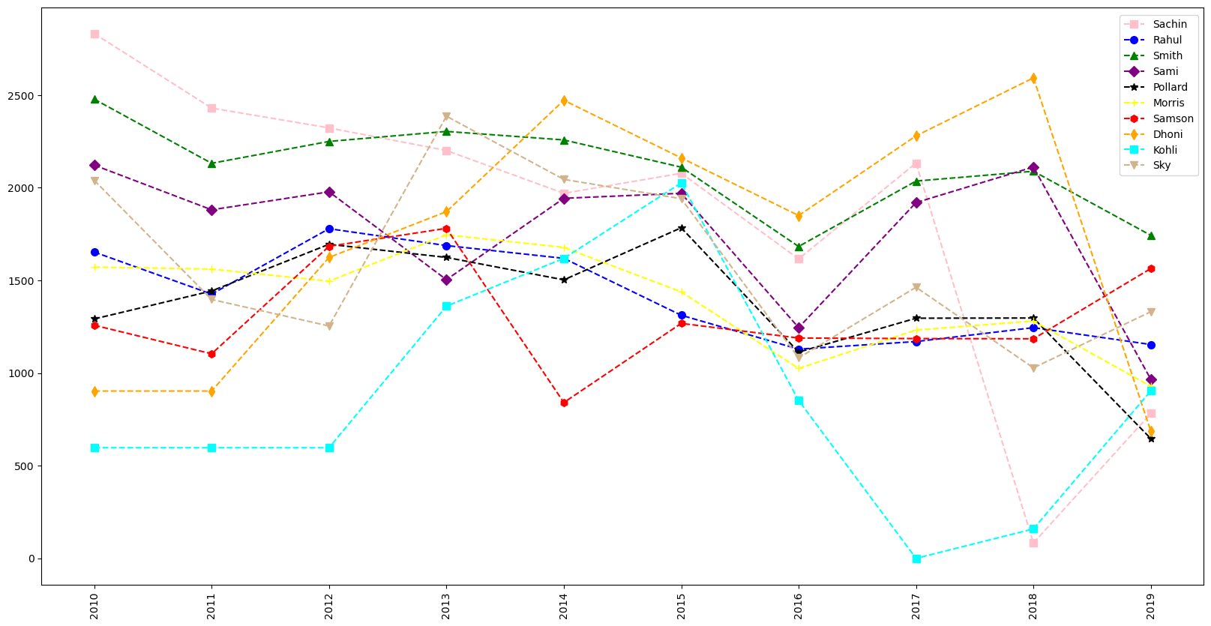
Other Parameters
Player
Points
scored

Slide 15
Thank you
Author: G. SATHVIK
sathvikganta10@gmail.com
https://github.com/SathvikGanta10

